Slide 1


Slide 2

Department of Computer Engineering
Project Title : Hybrid Energy inspired DC Micro-grid System using Machine Learning
Project Group ID/ Group details : 4
Project Guide : Dr. B. S. Tarle
Project Group Members :
1. Name: Sakshi Jadhav Seat No: B190294222
2. Name: Samruddhi Khairnar Seat No: B190294231
3. Name: Kunika Narnaware Seat No: B190294239
4. Name: Pranjal Shewale Seat No: B190294262

Slide 3
INTRODUCTION
Our project idea aims at the creation of a smart grid management system for hybrid energy power-plants using machine learning, where the energy generation can be controlled as per the estimated power demand as well as the real time demand, to ensure that there is minimum wastage of the electrical energy.
Renewable sources like solar and wind can power the grid while the load demand is low and as per the increase in the power demand, the conventional steam generators' power output can be regulated.

Slide 4
MOTIVATION
Sustainability of any country leads to its growth over a long term.
Thus, we must shift gradually towards the use of renewable energy as making a drastic shift might be costly.
Hence, Hybrid Power Plants will play a vital role in the power industry in coming years.
This is what motivated us to build a hybrid DC microgrid, in fulfillment of the final year project.

Slide 5
PROBLEM STATEMENT
We must gradually shift our focus to integrating non-polluting, renewable energy sources with the conventional grid system to harvest renewable energy economically, while ensuring minimal wastage of electricity generated conventionally.
Conventional power generation involves communication delays as well as extra power generation, which is usually grounded. Hence, a smart hybrid energy management system is necessary to control the integration of various energy sources.

Slide 6
SCOPE OF THE PROJECT
Assembling the entire wired setup of the DC microgrid and executing the switching and regulation of the sources.
Building our own dataset consisting of sensor readings, to measure the illumination, wind speed and other parameters relevant to our energy sources.
Training multiple models to estimate the power generation and forecast the load demand.
To try obtaining as good an accuracy at the predictions as mentioned in our base paper, while trying to make improvements.
Building a wireless micro-grid and securing it against data manipulation attacks, as part of future scope.

Slide 7
OBJECTIVES
1. Predict the power output generated by renewable energy generators.
2. Predict load demand of the users in the grid using previous days' / years' power usage readings.
3. Switch and regulate the energy sources based on the load / consumption of the users in real time.
4. Work on securing the system from cyber attacks as a part of future scope.

Slide 8
OPERATING CASES
When Demand < Renewable Generation :
Use Renewable Power, Extra power grounded / used for charging backups.
Renewable Generation < Demand < Power Plant Capacity :
Total Power output = Renewable + Conventional Generation (as per estimation using ML, uncertain loads can be handled using backups / batteries).
Power Plant Capacity < Demand :
Implement load shedding in the power line.

Slide 9
LITERATURE REVIEW
Sr. No. | Year | Authors and Journals | Name of Topic | Short Description
1 | 13 February 2023 | Mostafa M. Shibl, Loay S. Ismail, Ahmed M. Massou | An Intelligent Two-Stage Energy Dispatch Management System for Hybrid Power Plants: Impact of Machine Learning Deployment | The base paper [1] suggests the use of a two-stage machine learning based energy dispatch management system for hybrid power plants (HPPs) , designed to control renewable energy sources, reserve and backup energy sources. The first stage aims to forecast the power output of renewable energy sources, as well as the load demand. The second stage aims to coordinate the energy output of the reserve and backup sources to achieve the required objective.
2 | 22 January 2021 | Chun-Hung, Liu Jyh-Cherng Gu, Ming-Ta Yang | A Simplified LSTM Neural Networks for One Day-ahead Solar Power Forecasting | The second paper [2] made use of raw data collected from PV systems to train a model using a long short term memory approach to forecast one day-ahead solar power generation but did not explore other renewable energy sources.

Slide 10
3 | 5 september 2014 | Hossein Karami, Mohammad Javed Sanjari | An Optimal Dispatch Algorithm for managing Residential Distributed Energy Resources. | The third paper [3] deals with a residential hybrid thermal grid-connected home energy system, including a fuel-cell and a battery as energy storage system (ESS). A day-ahead scheduling algorithm for managing different resources is developed to generate an efficient look-up table that determines an optimal operation schedule for the distributed energy resources at each time interval, so that the operation cost of a smart house is minimized.
4 | 22 October 2014 | Bing Zhu, Henerica Tazvinga, Xiaohua Xia | Switched model predictive control for energy dispatching of a photovoltaic diesel battery hybrid power system. | Suggests an energy management system for HPP’s powered by PV and diesel batteries.
5 | 3 July 2021 | Baraa Mohandes,Maisam Wahbah, Mohamed Shawky El Moursi, Tarek H.M. El-Fouly | Renewable Energy Management System: Optimum Design and Hourly Dispatch. | Suggests the use of hourly scheduling of energy sources.

Slide 11
LIMITATIONS
The gaps which we identified in the base paper [1] were that all of the model training and testing was done using simulated datasets and not on any actual grid / microgrid system.
The second paper [2] made use of raw data collected from PV systems to train a model using a long short term memory approach to forecast one day-ahead solar power generation but did not explore other renewable energy sources.

Slide 12
DOMAIN ANALYSIS
STATISTICS (to justify the demand)
237.26 GW
Installed capacity of thermal power in India.
60 %
Of the total electricity generation in India.
₹ 7/unit
Average cost as of April ‘23.
64 %
Users are located in rural areas.
STAKEHOLDERS
Direct :
Electricity board
Microgrid users
Indirect :
End users

Slide 13
HARDWARE & SOFTWARE REQUIREMENTS
Minimum Hardware Requirement
Microprocessor - Intel Core i5 / i7 (>= 6th gen)
RAM - 4 GB or more (on AWS Virtual Machine)
Operating System Compatibility
Operating System - Linux
Linux comes with Python installed out of the box. Also, numerous security and forensics tools are freely available.

Slide 14
Programming Languages and Technologies
Python 3
Apache Kafka - Pub-Sub streaming platform.
Apache Spark - Large-scale data processing.
Development Tools and Environments
JupyterLab - Web-based interactive computing platform.
AWS EC2 - Virtual machines on the Elastic Cloud Compute.
Colab - For GPUs offered by Google’s web notebooks.

Slide 15
Software Frameworks and Libraries
Pandas
Scikit-Learn
Confluent-Kafka - To communicate with Kafka using Python.
PySpark : Distributed machine learning.
Dash : Library for building dashboards.

Slide 16
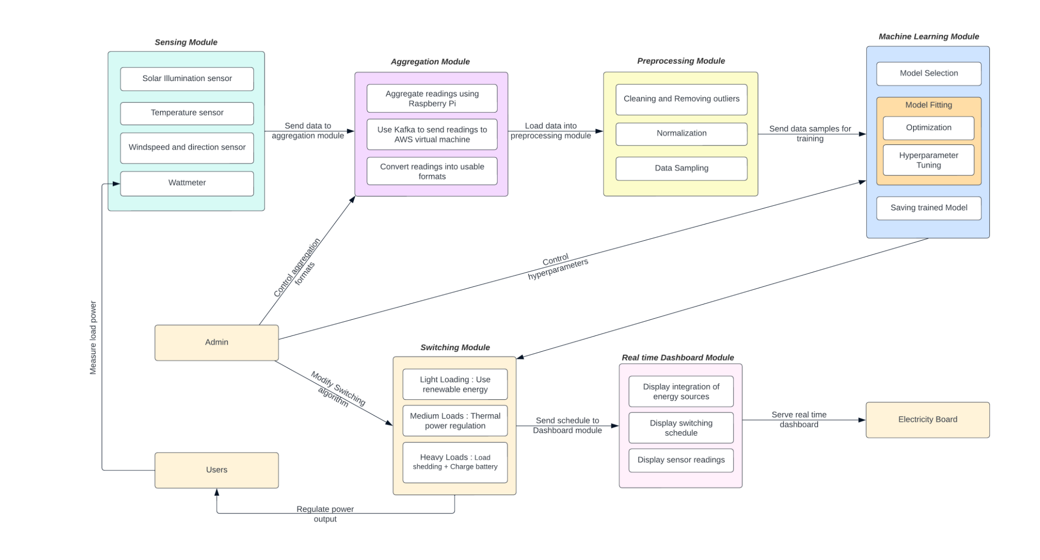
SYSTEM ARCHITECTURE

Slide 17
FUNCTIONAL REQUIREMENTS
System Features
Renewable power output prediction.
Load demand forecasting.
Switching and regulation of energy sources.
Database Management System (DBMS)
The sensor readings will be aggregated - illumination, wind speed, using a Raspberry Pi Pico and pushed onto cloud storage, in the form of JSON. On cloud, this data will be stored as CSV files, hence our databases will actually be datasets along with trained models.

Slide 18
NON FUNCTIONAL REQUIREMENTS
Software Quality Attributes
1. Reliability : Reliable power estimates.
2. Portability : Accessible from anywhere, dashboard will be hosted on cloud.
3. Usability : User friendly dashboard.
Operational and Maintenance Considerations
For maintenance of the trained model and prevention of corruption of the files, cronjobs will be scheduled for repeatedly training models at regular intervals.

Slide 19
Scalability and Performance
The proposed system is designed considering a DC microgrid. As the system scales, multiple remote virtual machines can be integrated for training and serving purpose. Also, the system makes use of Apache Spark for distributed machine learning and a lightweight, responsive dashboard library - Dash, hence the system will perform efficiently.
Security Considerations
As part of security, we hope to secure the physical setup of our project from external threats like fire and water. Also, we will work on securing our system against man in the middle attacks, as part of future scope.

Slide 20
Security and Access Control
We will ensure that the virtual instance can only be accessed by authorized persons, through SSH, by storing the private keys required to login, in hidden files, which will be password protected.
Version Control and Source Code Management
Git and GitHub will be used.

Slide 21
EXTERNAL INTERFACE REQUIREMENTS
User interfaces
Intuitive and easy to interpret dashboard.
Software Interfaces
A set of Python scripts, deployable on local as well as remote machines. The admin of the system (electricity board head) will be able to modify the scripts.

Slide 22
Hardware Interfaces
The proposed system will be executed in the form of a prototype, simulating an actual DC microgrid.
Hardware Components
Raspberry Pi Pico W
Solar Panel, Charge Controller and Lead Acid Battery
DC Adaptor, Motor, Relay
For future modules - RF Transceivers, Wireless Network Adaptor, Steam generator and steam burner flame controller.

Slide 23
Communication Interfaces
Our trained model will be deployed on a virtual machine hosted on AWS EC2.
Network and Communication Protocols
IEEE 802.11 (Wifi) : To transfer data to and from the Raspberry Pi module and the AWS virtual instances.
SSH (Secure Shell) : For secure remote access to and control devices and servers over an encrypted connection.

Slide 24
ALGORITHMS
For predictions, we will make use of numerous ML and Deep Learning algorithms and the use the one which gives the best validation accuracy.
The algorithms we will be exploring -
Decision trees
SVM
Deep neural networks
LSTMs

Slide 25
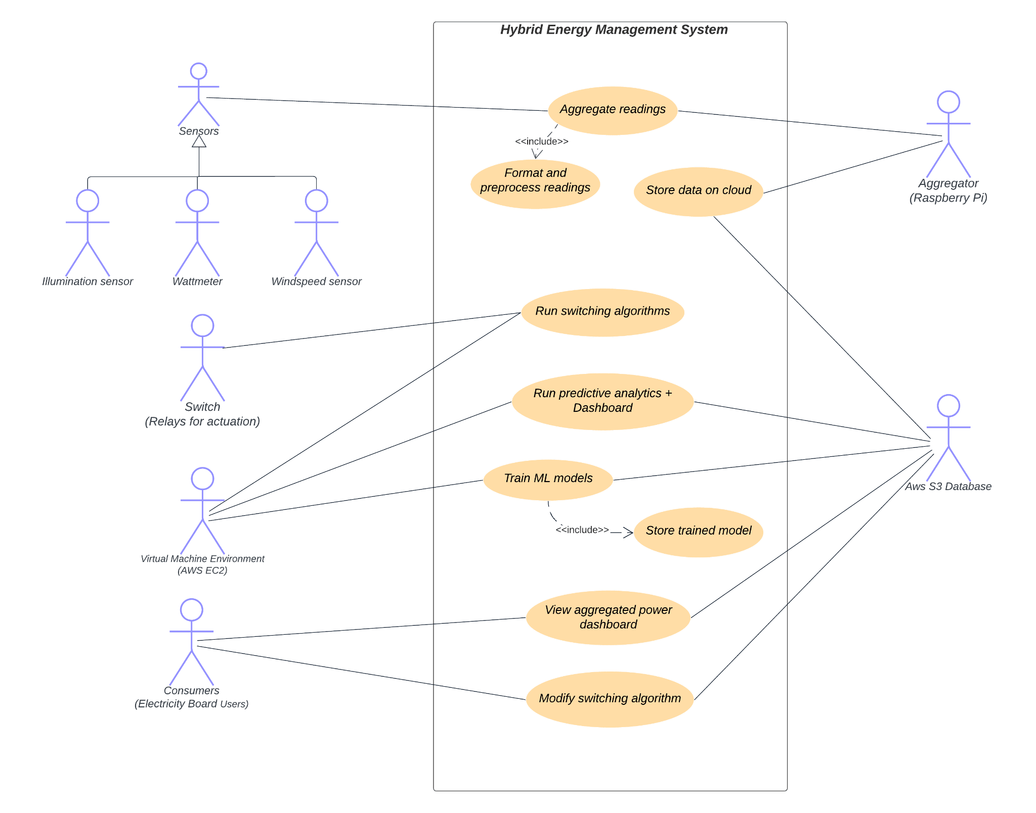
DESIGN : USE CASE DIAGRAM

Slide 26
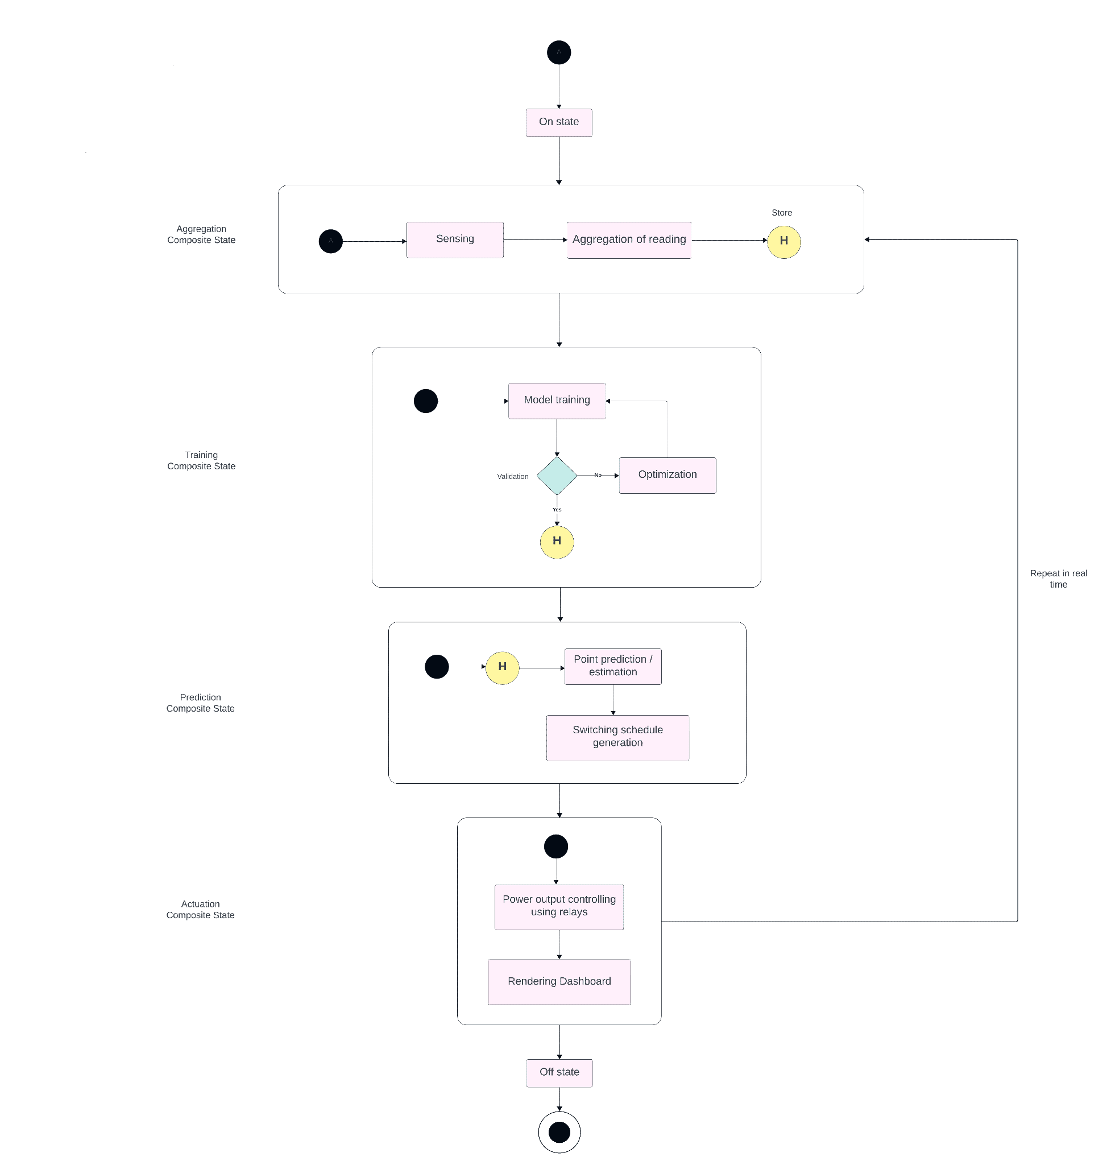
STATE CHART DIAGRAM

Slide 27
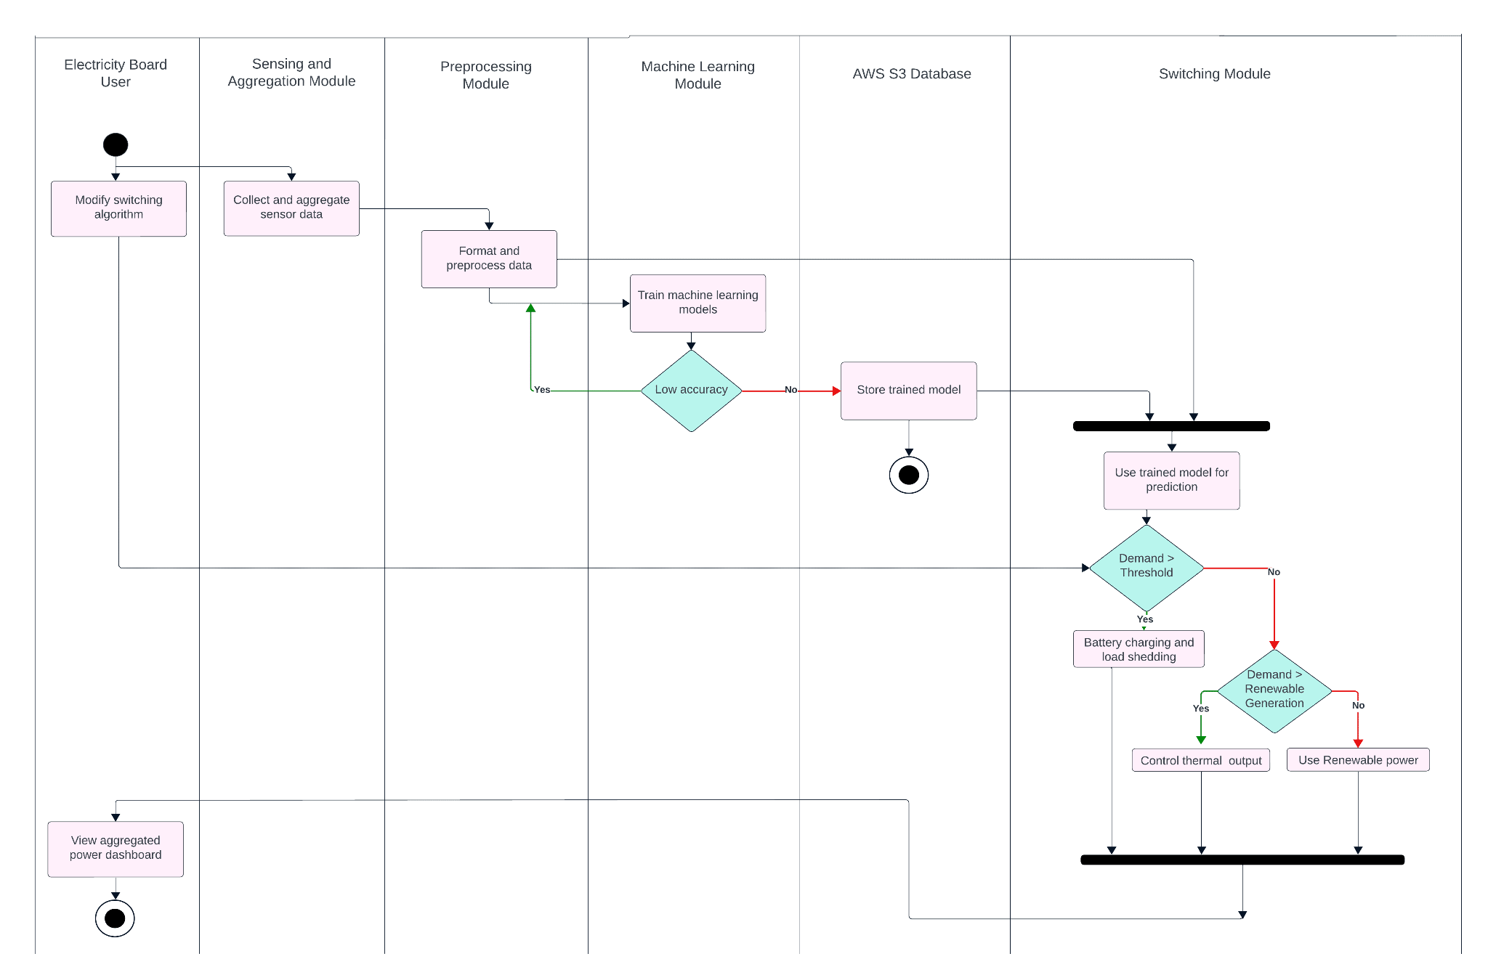
ACTIVITY DIAGRAM

Slide 28
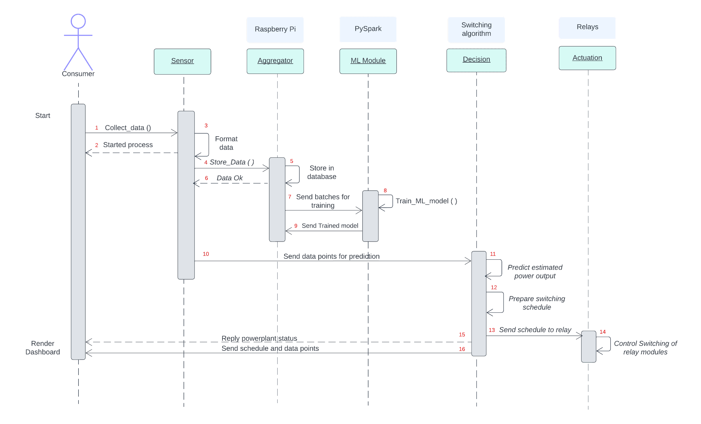
SEQUENCE DIAGRAM

Slide 29
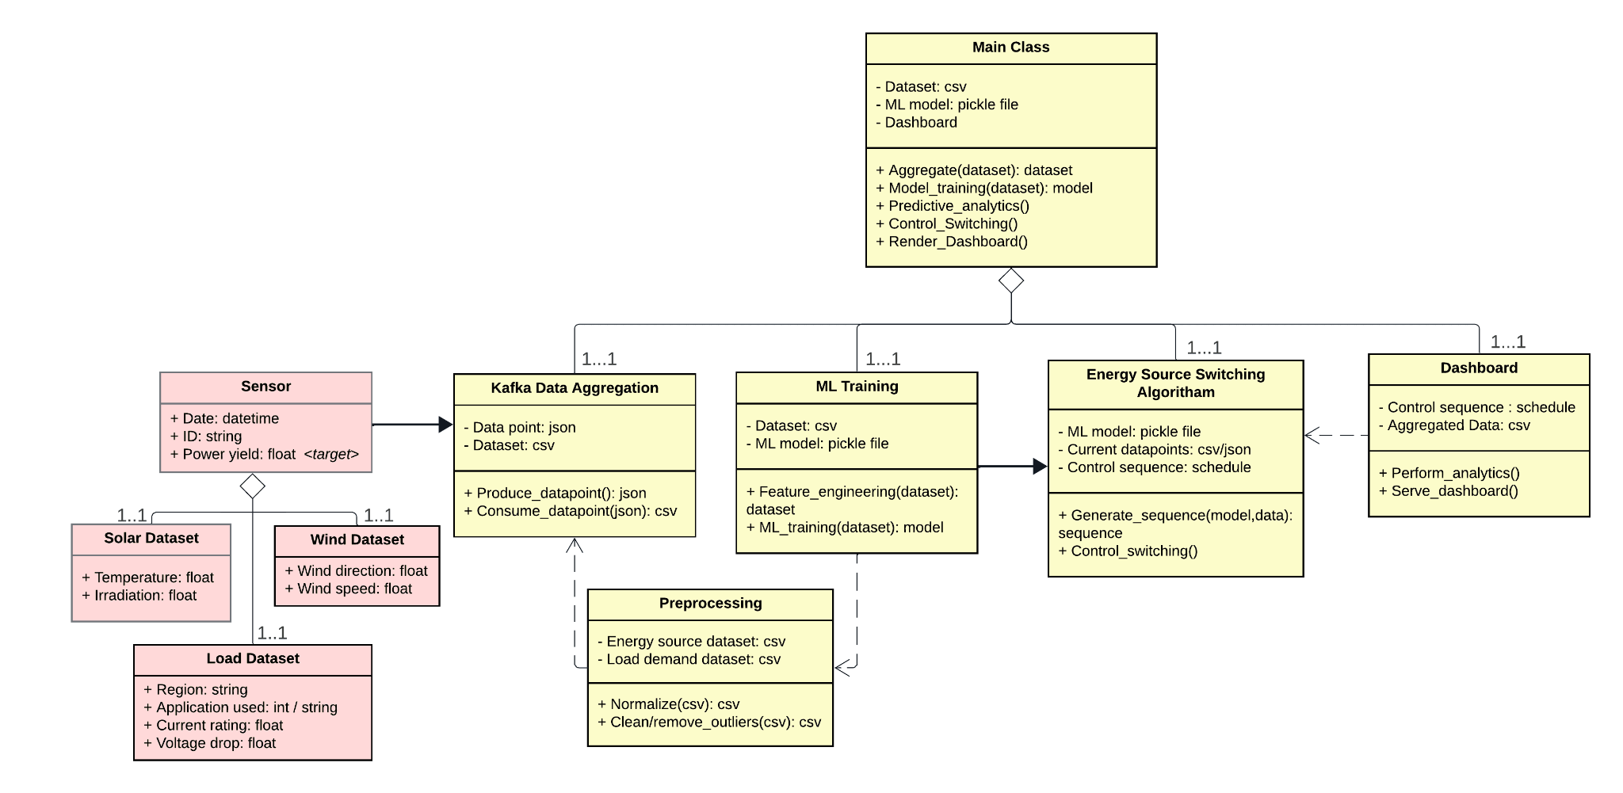
CLASS DIAGRAM

Slide 30
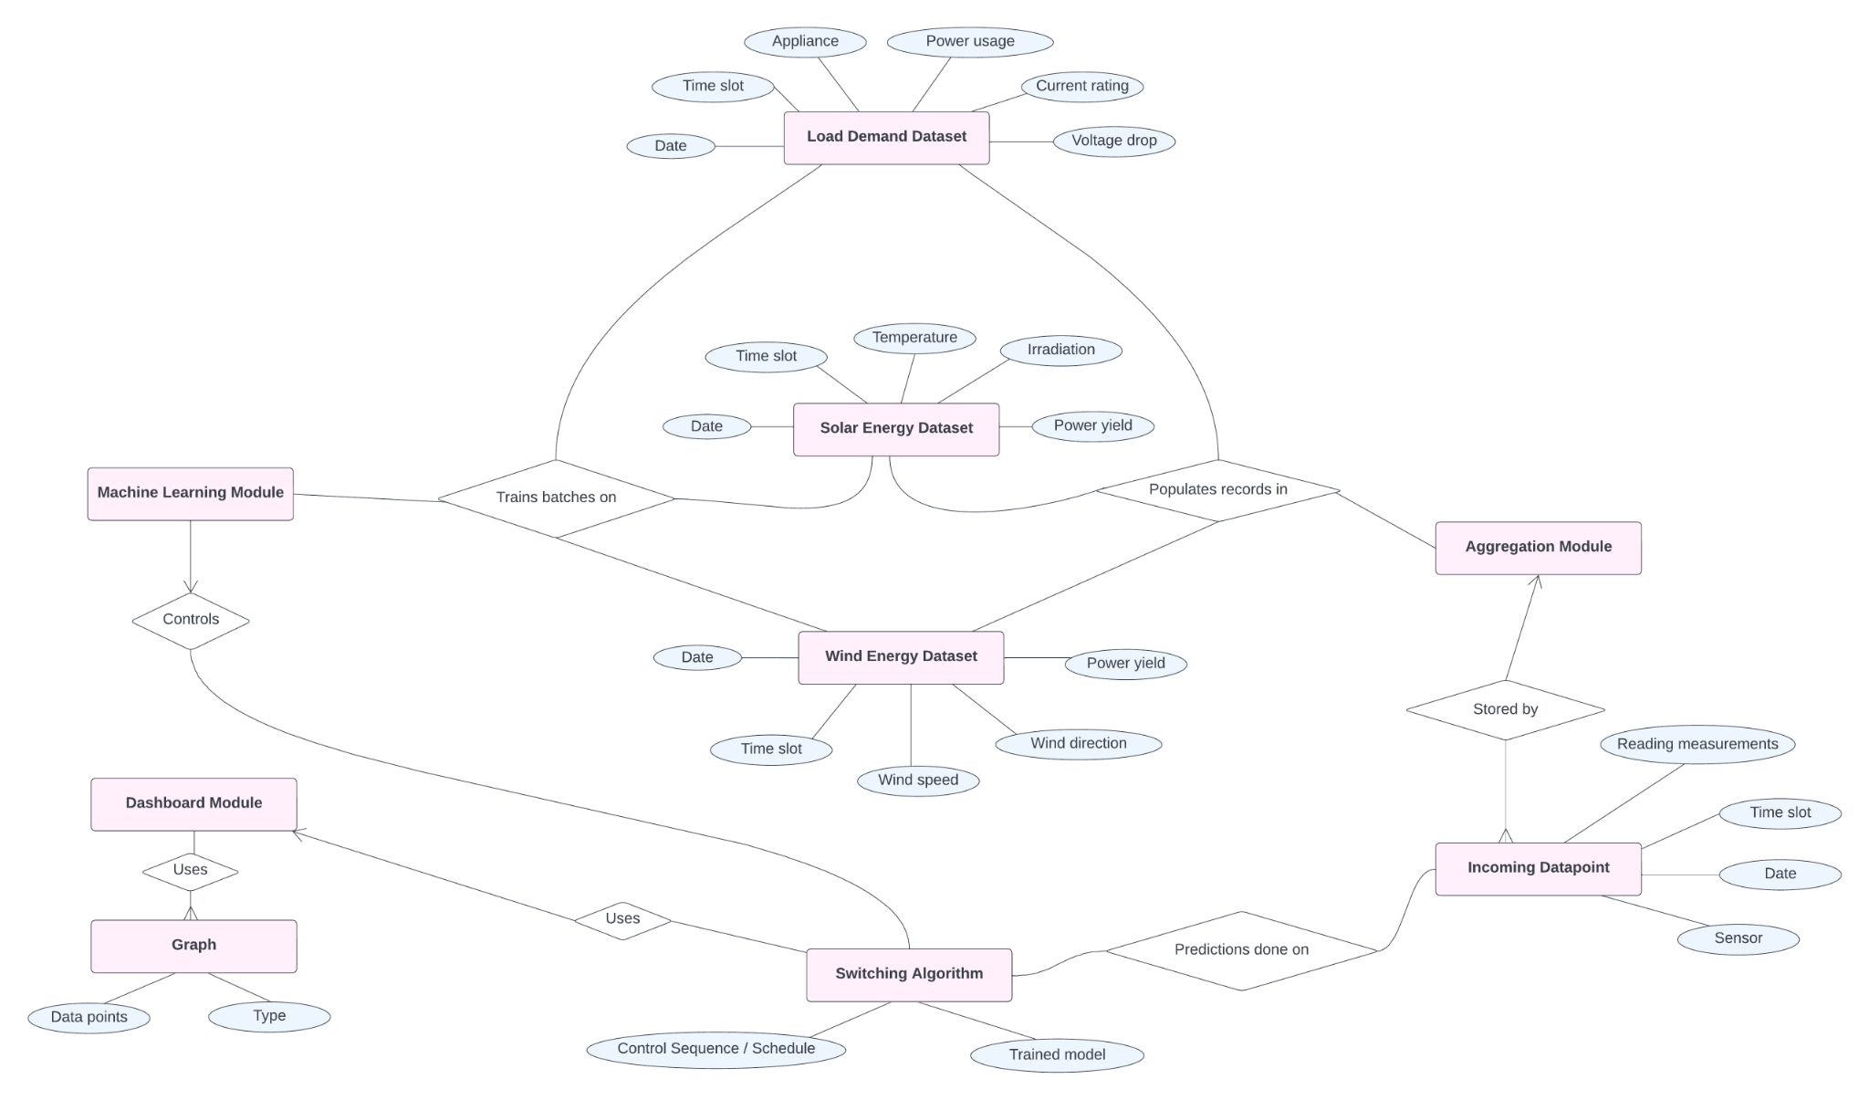
ER DIAGRAM

Slide 31
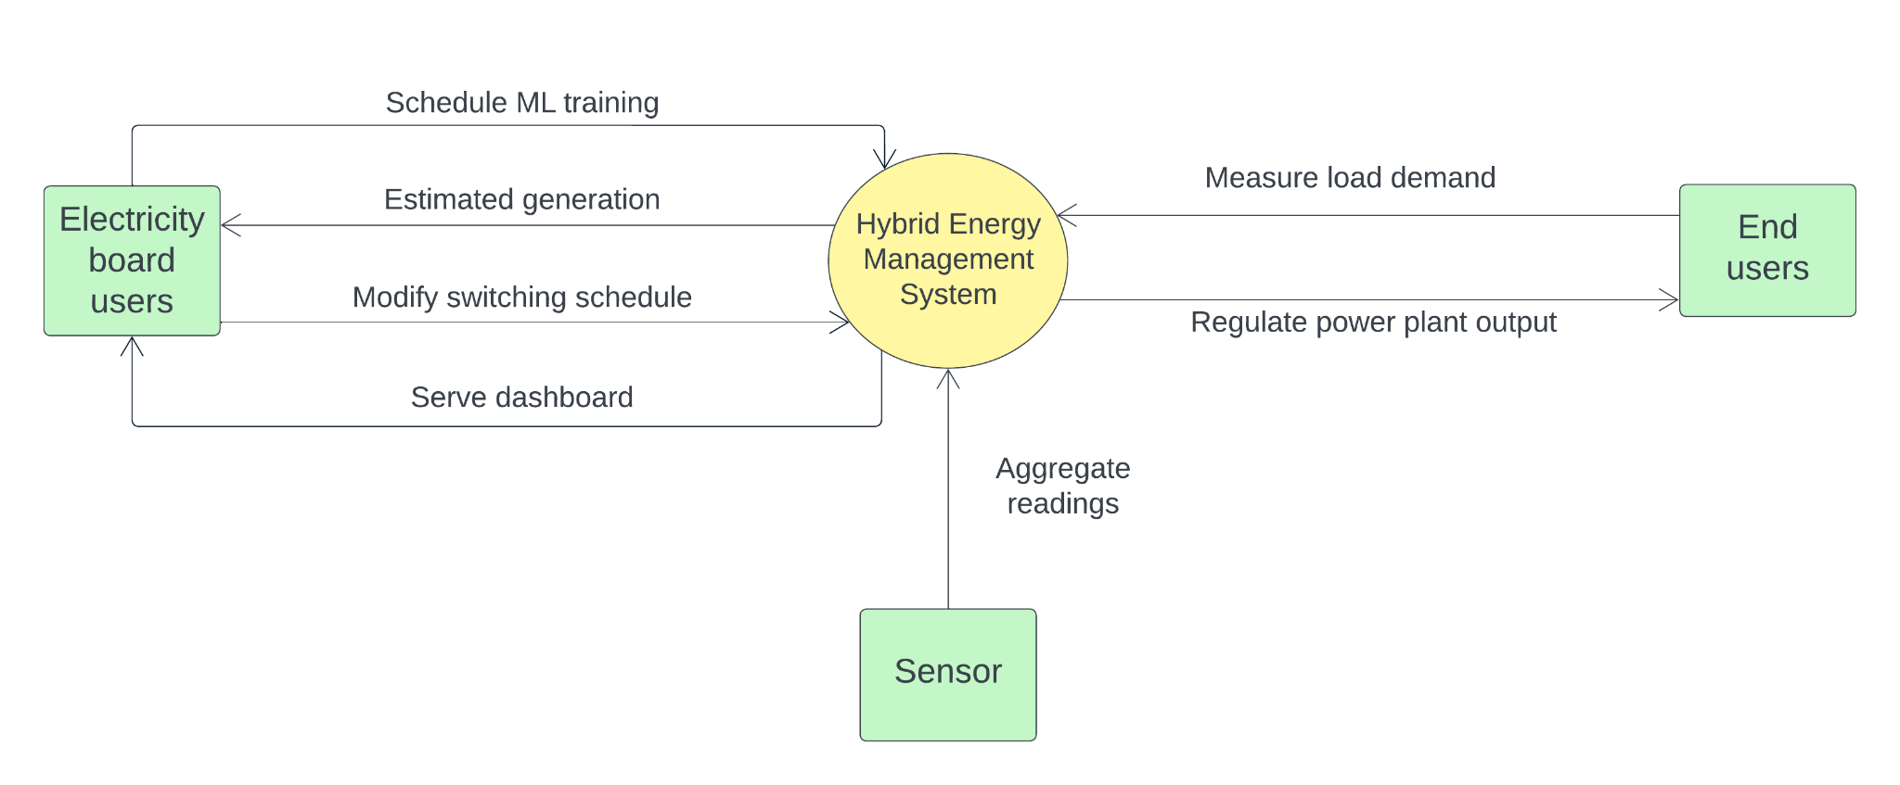
DFD LEVEL 0 DIAGRAM

Slide 32
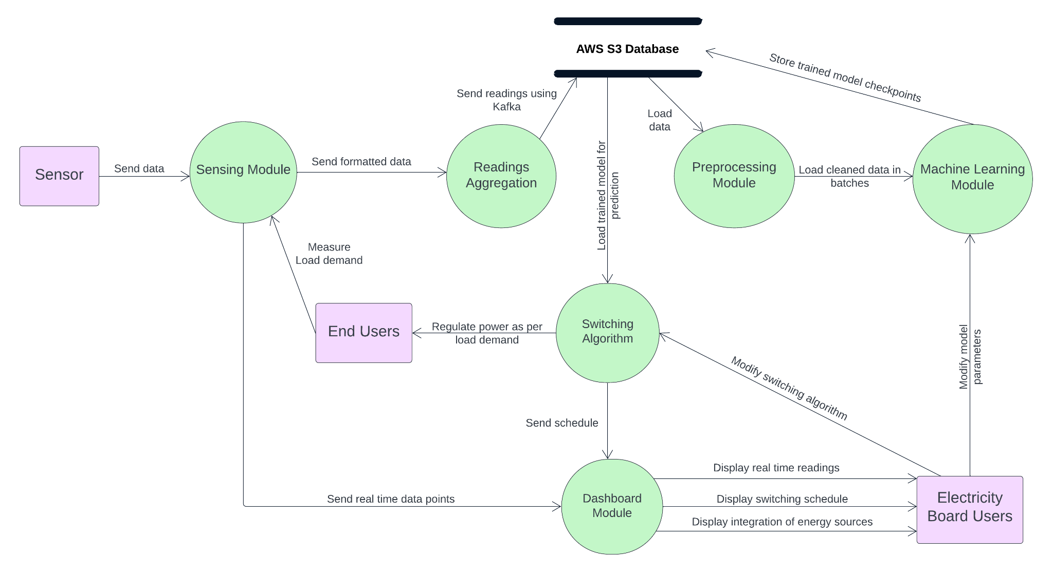
DFD LEVEL 1 DIAGRAM

Slide 33
RISK ANALYSIS
Risk ID | Risk Name | Type | Impact (1-10) | Backup Plan
1 | Hardware / Component Failure. | Technical Risk | 8 | Keep backup components at hand.
2 | Remote Consumer / ML program not reachable. | Operational Risk | 5 | Keep a local computer as a backup for remote ML.
3 | Execution of the project in the real world would be challenging. | Business Risk | 3 | Communicate with stakeholders in the electricity department board, for real world feasibility analysis.

Slide 34
PLANNING AND PROTOTYPING
Operating Environment
Our system will work in the physical setup of a DC microgrid, connected with the virtual machine instance running the machine learning scripts, via the Internet / WiFi hotspot.

Slide 35
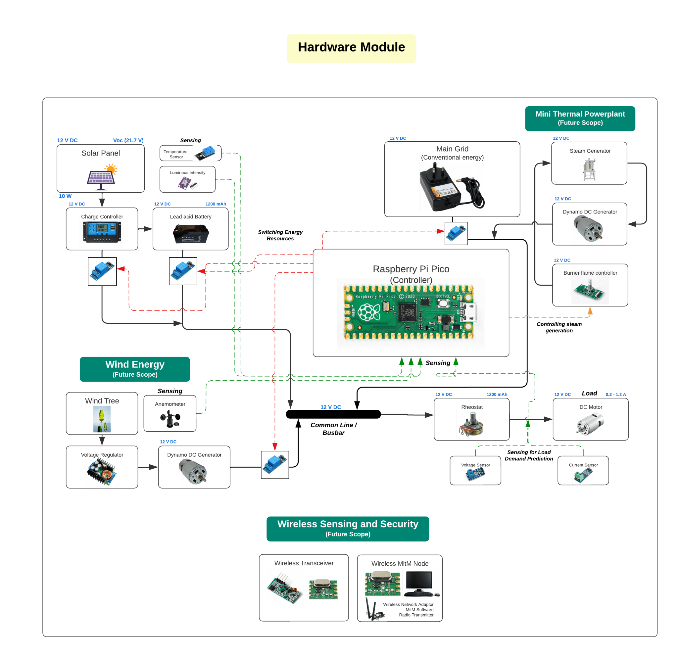

Slide 36
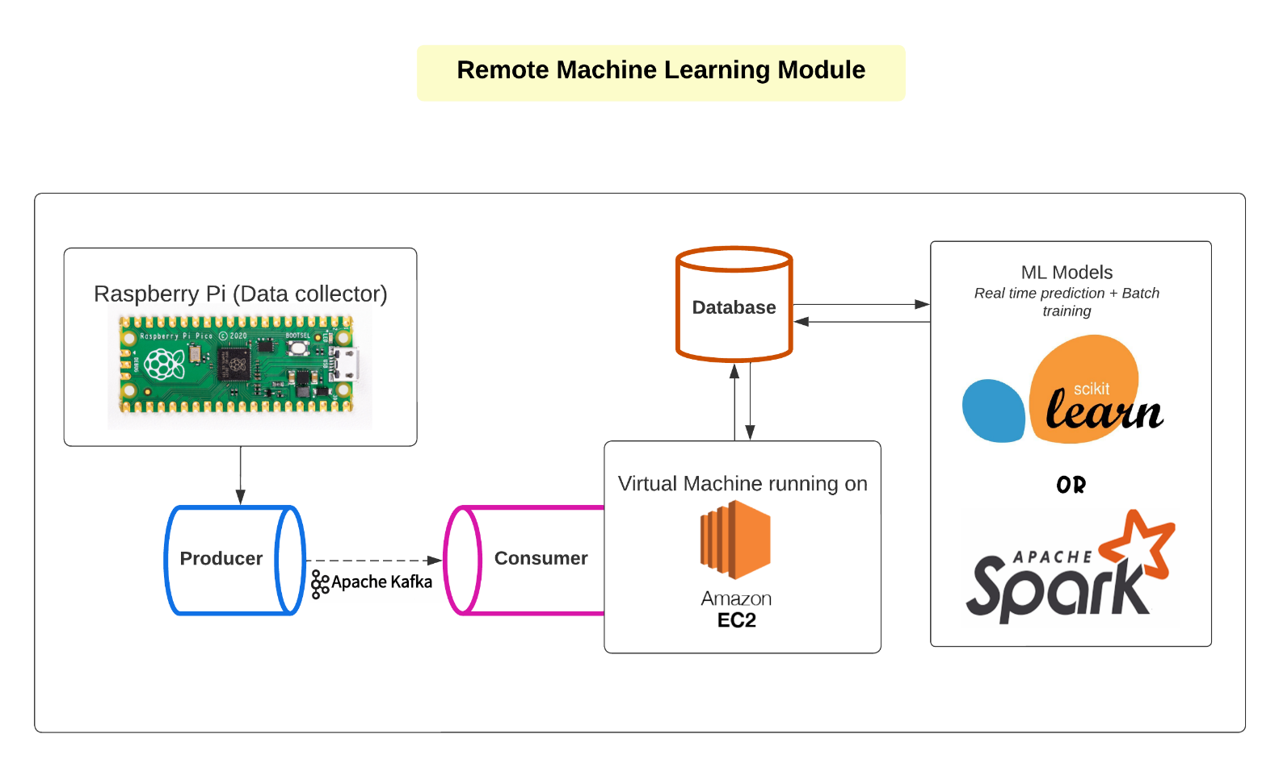

Slide 37
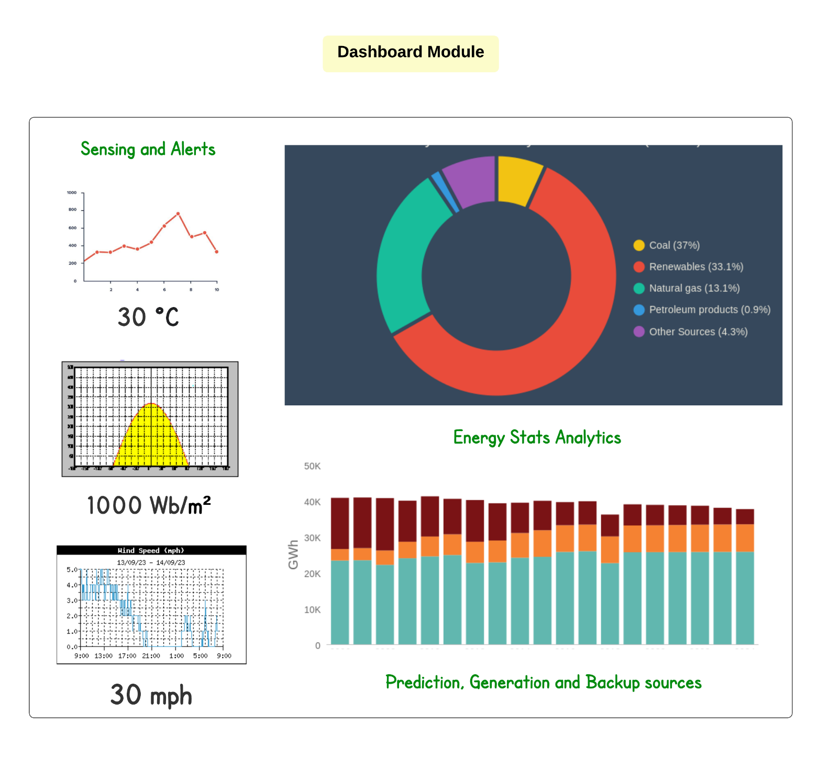

Slide 38
PROJECTED COST AND FEASIBILITY
Hardware Cost : ₹ 10-15,000
Software Development Cost : (COCOMO model)
Effort Estimation (E):
E = a * (KLOC^b) = 3 * (0.8^1.12) ≈ 2.144 person months
Development Time Estimation (D): D = c * (E^d) = 2.5 * (2.144^0.35) ≈ 2.55 months
Cost Estimation (C): C = D*X = 2.55 * 40000 ≈ ₹ 1,02,000 Lakh

Slide 39
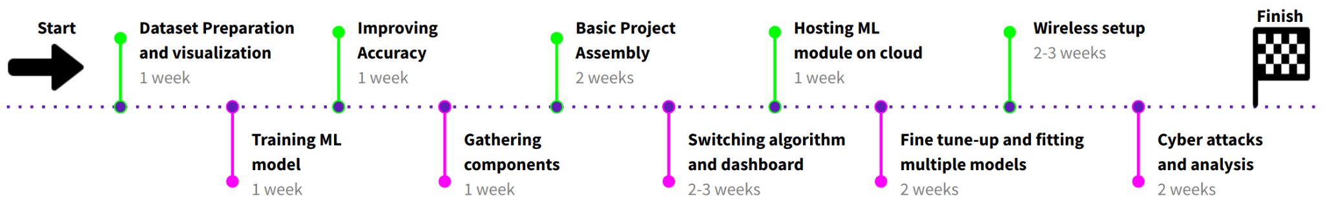
PROJECT SCHEDULE

Slide 40
Advantages
• Aggregating various distributed energy sources together.
• Reducing the average cost of generation of electricity per unit.
• Ease the work of electricity board users, by automating the communication process.
Applications
• Control distributed hybrid energy systems for integration of generated electricity.
• Predicting time series behavioral data of users to obtain their estimated power requirement, which can be applied to sectors other than power.

Slide 41
Conclusion
Hence, we have proposed a hybrid energy management system for DC micro-grids :
• Having a full fledged hybrid energy management system.
• To have a system , to predict as well as sense real time load demand.
• To have a fully working real time Dashboard.
Future Work
Work on building a wireless microgrid and study more on securing this wireless smart grid against data manipulation attacks. Also, we will try to integrate a steam generator and show the controlling of the thermal output using burner flame controlling knobs.

Slide 42
REFERENCES
[1] Mostafa M. Shibl, Loay S. Ismail, Ahmed M. Massou (2023) An Intelligent Two-Stage Energy Dispatch Management System for Hybrid Power Plants: Impact of Machine Learning Deployment, https://ieeexplore.ieee.org/document/10038701
[2] Chun-Hung Liu, Jyh-Cherng Gu, Ming-Ta Yang (2021) A Simplified LSTM Neural Networks for One Day-ahead Solar Power Forecasting, https://ieeexplore.ieee.org/document/9333638
[3] Baraa Mohandes, Maisam Wahbah, Mohamed Shawky El Moursi, Tarek H.M. El-Fouly (2021) Renewable Energy Management System: Optimum Design and Hourly Dispatch, https://ieeexplore.ieee.org/document/9351770
[4] Bing Zhu, Henerica Tazvinga, Xiaohua Xia (2014) switched model predictive control for energy dispatching of a photovoltaic diesel battery hybrid power system https://ieeexplore.ieee.org/document/6933909
[5] Hossein Karami, Mohammad Javad Sanjari,Seyed Hossein Hosseinian, G. B. Gharehpetian (2014) An Optimal Dispatch Algorithm for Managing Residential Distributed Energy Resources, https://ieeexplore.ieee.org/document/6878479
[6] Team National Smart Grid Mission (2023) Smart Grid Pilot Projects under IPDS (erstwhile RAPDRP Part-C), https://www.nsgm.gov.in/en/sg-pilot
[7] Ankit Gupta (2023) Smart Grid Market Overview, https://www.marketresearchfuture.com/reports/smart-grid-market-1110
[8] Team Wikipedia (2023) Smart Grid, https://en.wikipedia.org/wiki/Smart grid
[9] Team SAP (2023) The smart grid: How AI is powering today’s energy technologies — SAP Insights, https://www.sap.com/insights/smart-grid-ai-in-energy-technologies.html
[10] Kamil Talar (2023) Understanding what is Peak Shaving: Techniques and Benefits, https://howtostoreelectricity.com/what-is-peak-shaving
[11] Team IBEF (2023) Power Sector - India, https://www.ibef.org/industry/power-sectorindia.
[12] Stephen Turner, Suleyman Uludag (2015), https://www.researchgate.net/publication/2 76288597 Towards Smart Cities Interaction and Synergy of the Smart Grid and Intelligent Transportation Systems

Slide 43
THANK YOU

